Slide 1
N-gram Categorization algorithm -by chirag gajiwala

Slide 2
Introduction
What is N-gram?
N gram is a probabilistic language modelling of basic units, where the basic units can be words, phonemes, letters etc.
It is basically a contiguous sequence of n-items from a given sequence of text or speech.
N gram is basically a type of probabilistic language model for predicting the next item in such a sequence in the form of a (n-1) order Markov model.
N-grams and their relative frequencies will form the basis of our prediction algorithm.

Slide 3
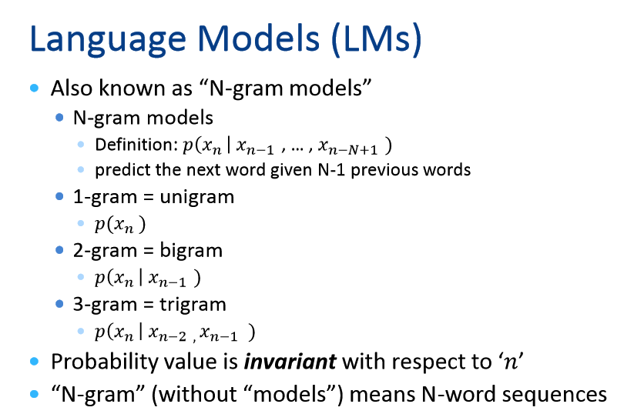

Slide 4
Description
In the fields of computational linguistics and probability, an n-gram is a contiguous sequence of n items from a given sequence of text or speech.
The items can be phonemes, syllables, letters, words or base pairs according to the application.
The n-grams typically are collected from a text or speech corpus.
We use the previous n-1 words to predict the next word.
An n-gram of size 1 is referred to as a "unigram"; size 2 is a "bigram" (or, less commonly, a "digram"); size 3 is a "trigram".
The assumption that the probability of a word depends only on the previous Markov word is called a Markov assumption. Markov models are the class of probabilistic models that assume we can predict the probability of some future unit without looking too far into the past.
https://www.youtube.com/watch?v=s3kKlUBa3b0
https://www.youtube.com/watch?v=o-CvoOkVrnY

Slide 5
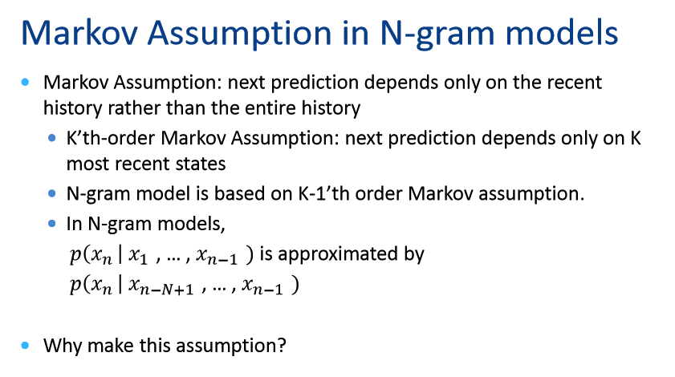

Slide 6
Markov Model
Markov model is a stochastic model used to model randomly changing systems.
It is assumed that future states depend only on the present state and not on the sequence of events that preceded it.
There are 4 Markov models used in practice.
Markov chain: State of a system with a random variable changing through time.
Hidden Markov Model: Is a Markov chain for which the state is only partially observable.
Markov Decision process: Used in decision making process where outcomes are partly random and partly under the control of decision maker.
Partially observable Markov decision process: The state of the system is only partially observed. Generalization of Markov decision process.

Slide 7
More about Markov models
Markov models: https://www.youtube.com/watch?v=7KGdE2AK_MQ
When two events, A and B, are dependent, the probability of both occurring is:
P(water is transparent) = P(water) X P(is | water) X P(transparent | water is)
Either way, the Markov Assumption means that you don’t need to go too far back in history to predict tomorrow’s outcome. You can just use the most recent past event.
Markov models and Hidden Markov Models are canonical models for the analysis of temporal or sequential data.

Slide 8
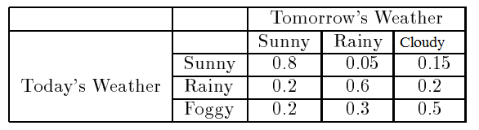
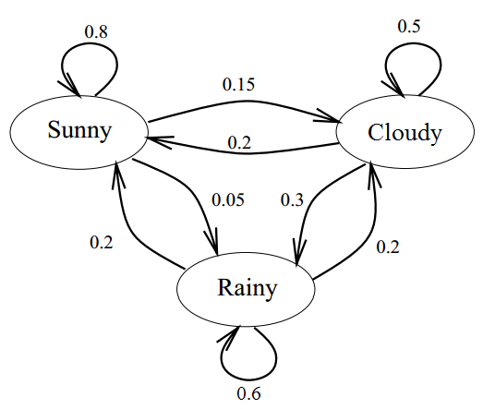
Calculating probability using hidden markov
P(w2= sunny,w3=rainy|w1=sunny)
P(w2= sunny,w3=rainy|w1=sunny) | = P(w2=sunny|w1=sunny) * P(w3=rainy|w2=sunny,w3sunny)
 | = P(w2=sunny|w1=sunny) * P(w3=rainy|w2=sunny)
 | = 0.8 * 0.05
 | =0.04

Slide 9
Advantages
This algorithm has the advantage that it boosts the n-gram counts of the expanded words, making the resulting predictions more accurate.
Simplicity and Scalability- with larger n values, a model can store more information into it.
The primary advantage of this approach is that it is ideally suited for text coming from sources such as email.
An N-gram-based approach to text categorization is tolerant of textual errors.

Slide 10
Disadvantages
Not all contractions can be expanded like this without taking context into account e.g. does “’s” denote possession or is it a contraction of “is”? Some hybrid approach is probably best.
However, unlikely to be sufficient for a good algorithm.

Slide 11
What application uses this algorithm?
Spell checking system uses this algorithm.
Speech recognition system uses this approach.
Statistical Natural language processing.
Text mining.
Probability and computational linguistics.
Bioinformatics.

Slide 12
Example:
In analyzing text documents, we can count the frequency of words appearing together in a fixed order.
“A Major League Baseball game was held in Salt Lake City 40 years ago”.
1-grams are: {a, Major, League, Baseball, game, was, held, in, Salt, Lake, City, 40, years, ago}-1 gram: simple coma separated value.
2-grams are: {a Major, Major League, League Baseball, Baseball game, game was, was held, held in, ... }-except 1st and last word, all other words are repeated.
3-grams are: {a Major League, Major League Baseball, League Baseball game, Baseball game was,...}
How many N-grams in a sentence?
If X=Num of words in a given sentence K, the number of n-grams for sentence K would be:
Ngrams = X-(N-1)
“Water is transparent”.
P(water is transparent) = P(water) X P(is | water) X P(transparent | water is)

Slide 13
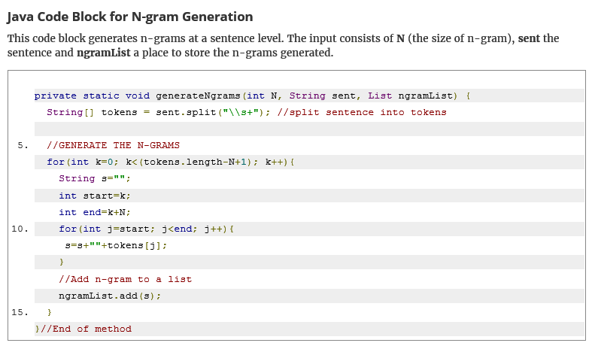
Java code for n-gram generation

Slide 14
R code
install.packages (" ngram ")
letters
library(ngram)
concat(letters)
concat ( concat ( letters ) , letters , collapse =" ")
x <- "A B A C A B B"
library ( ngram )
ng <- ngram (x , n =2)
ng
print (ng , full = TRUE )
babble (ng , 10)
babble (ng , 10)
babble (ng , 10)
#To specify your own seed, use the seed=argument:
babble (ng , 10 , seed =10)

Slide 15
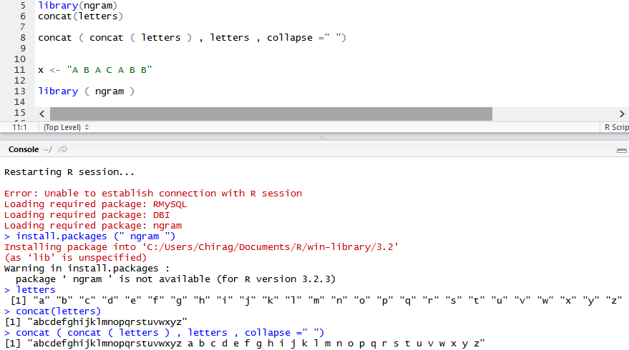

Slide 16
Results
> install.packages (" ngram ")
Installing package into ‘C:/Users/Chirag/Documents/R/win-library/3.2’
(as ‘lib’ is unspecified)
> letters
[1] "a" "b" "c" "d" "e" "f" "g" "h" "i" "j" "k" "l" "m" "n" "o" "p" "q" "r" "s" "t" "u" "v" "w" "x" "y" "z"
> library(ngram)
> concat(letters)
[1] "abcdefghijklmnopqrstuvwxyz"
> concat ( concat ( letters ) , letters , collapse =" ")
[1] "abcdefghijklmnopqrstuvwxyz a b c d e f g h i j k l m n o p q r s t u v w x y z"
> x <- "A B A C A B B"
> ng <- ngram (x , n =2) #function
> ng
[1] "An ngram object with 5 2-grams"
> print (ng , full = TRUE )
C A

Slide 17
References
http://odur.let.rug.nl/~vannoord/TextCat/textcat.pdf
https://cran.r-project.org/web/packages/ngram/vignettes/ngram-guide.pdf
http://research.microsoft.com/pubs/79488/p672-shen.pdf
https://www.youtube.com/watch?v=s3kKlUBa3b0
http://guizzetti.ca/blogs/lenny/tag/markov-model/

